Slide 1
JavaScript
Desenvolvimento web para bioinformática
Aula 4

Slide 2
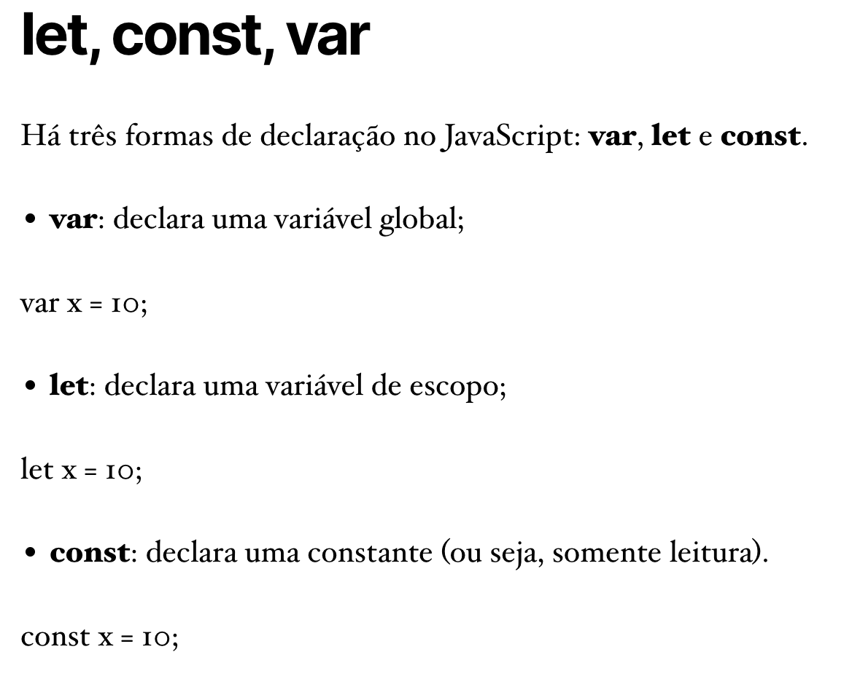
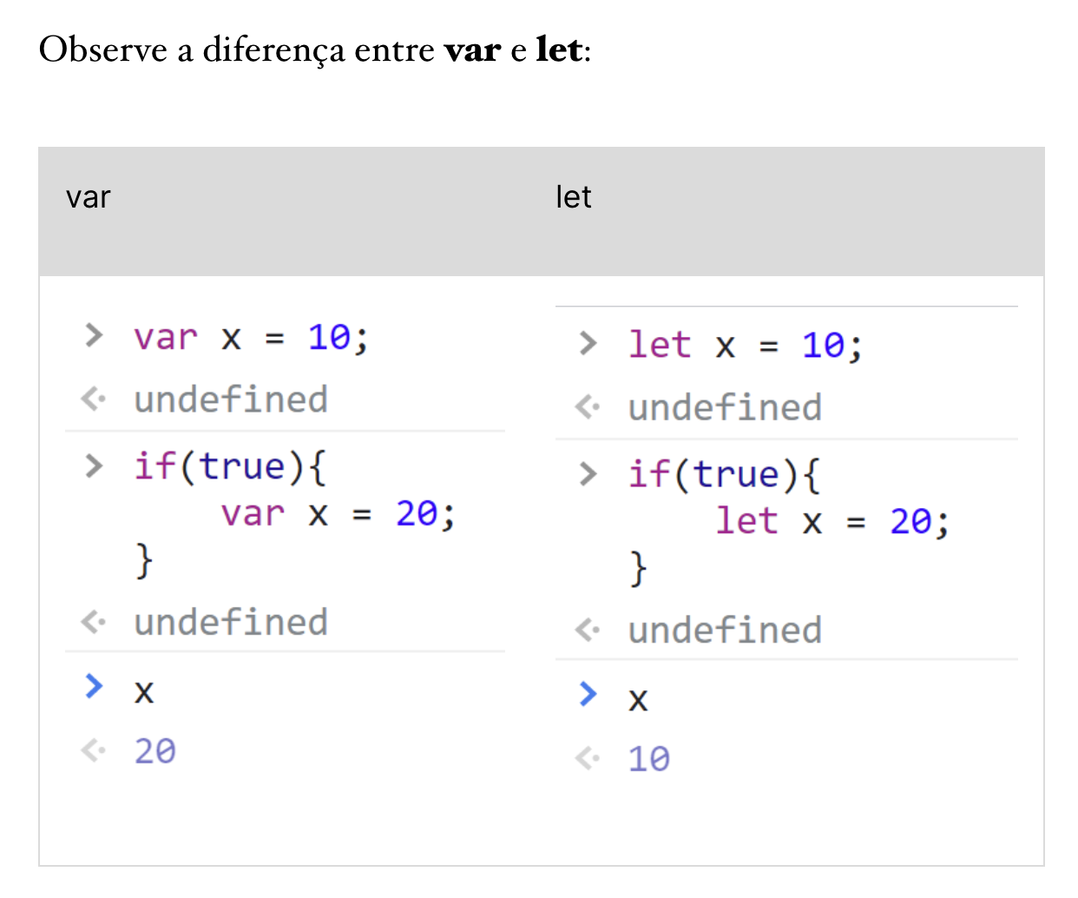

Slide 3
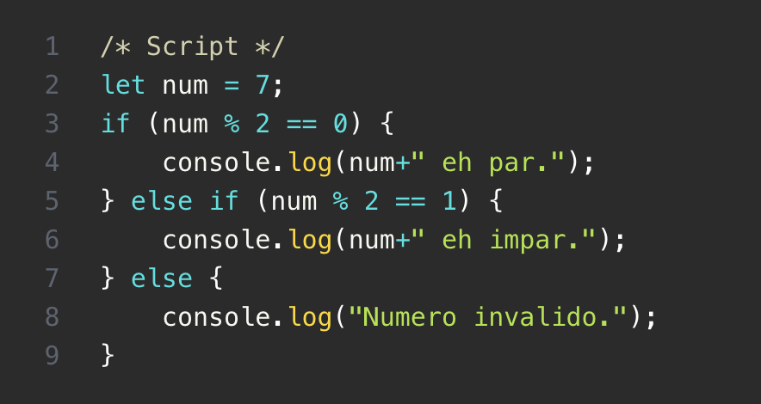
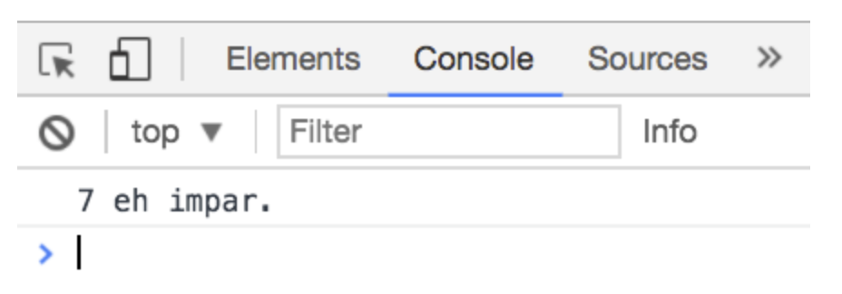
Comandos condicionais if/else

Slide 4
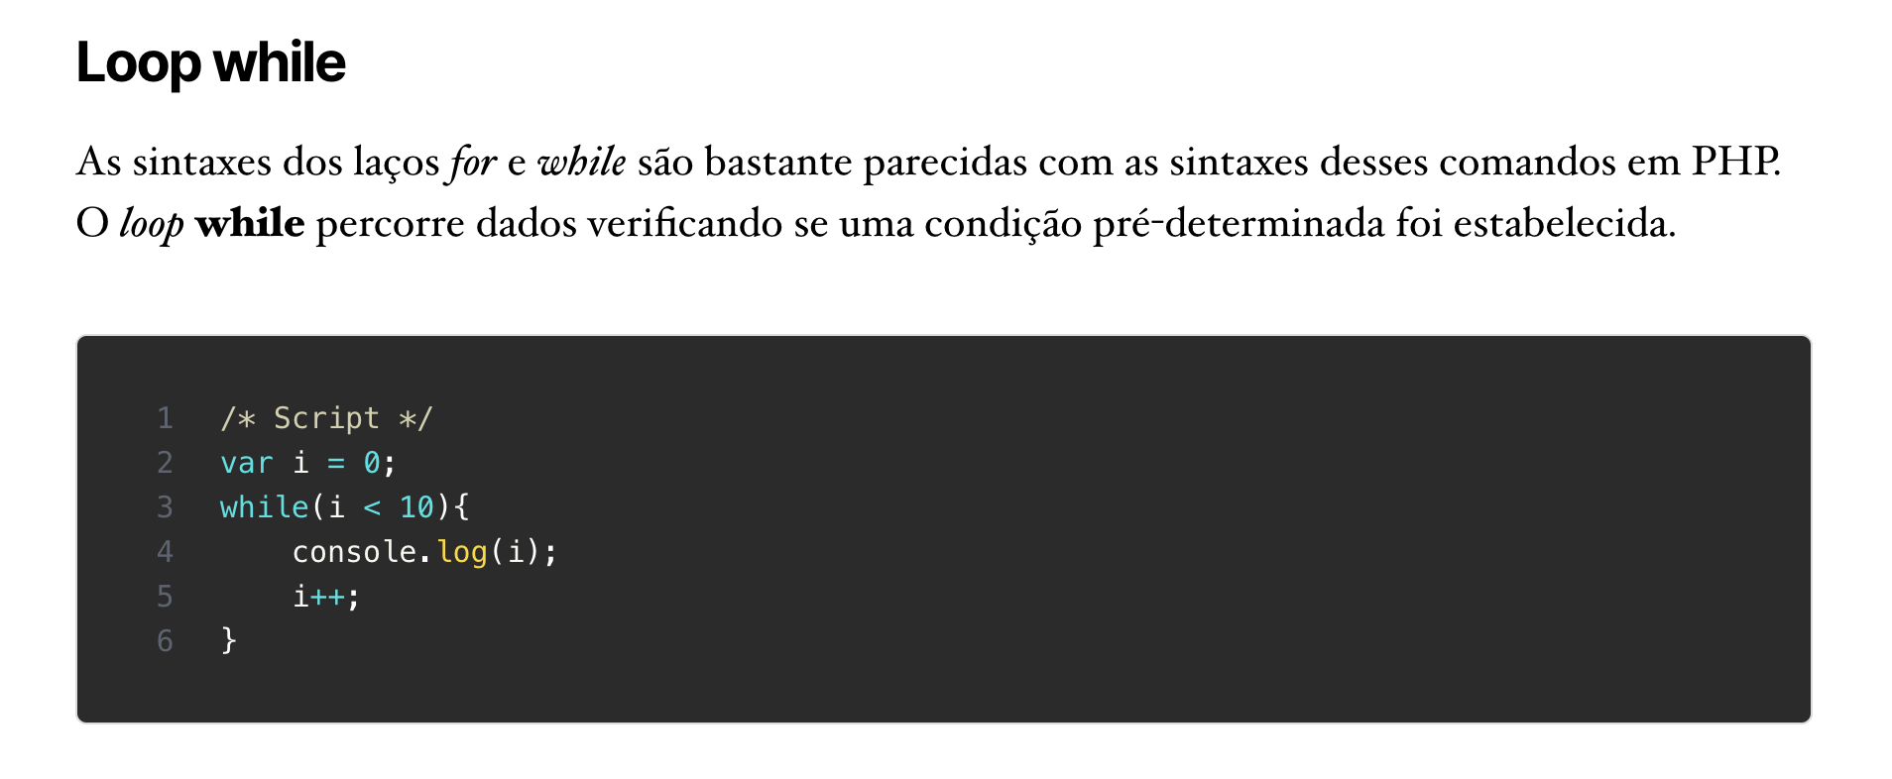

Slide 5
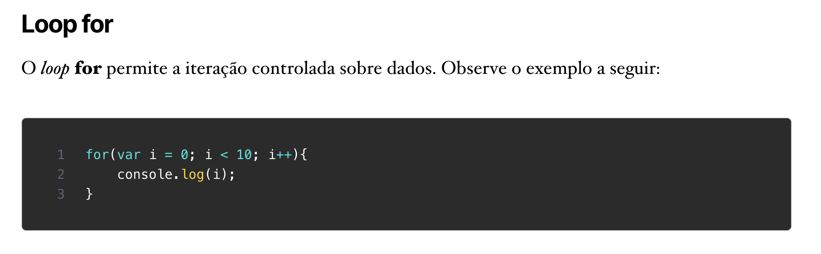

Slide 6
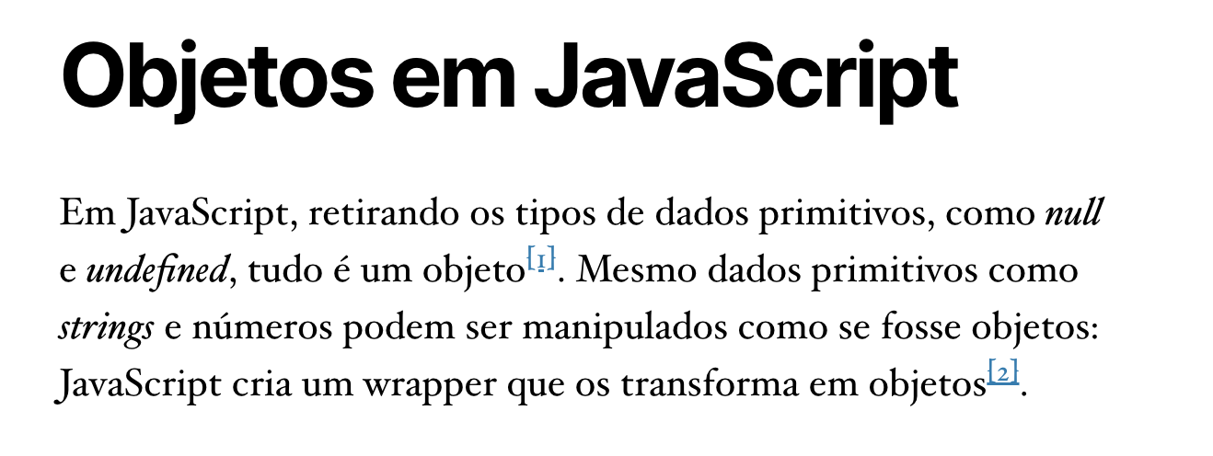
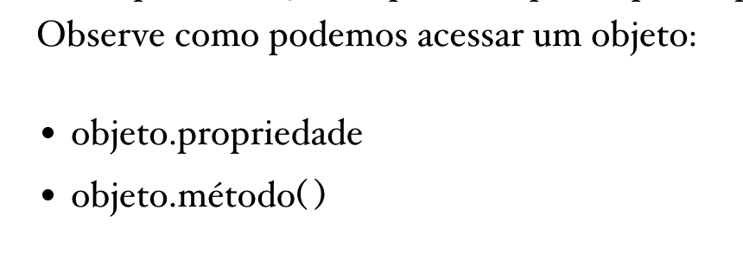
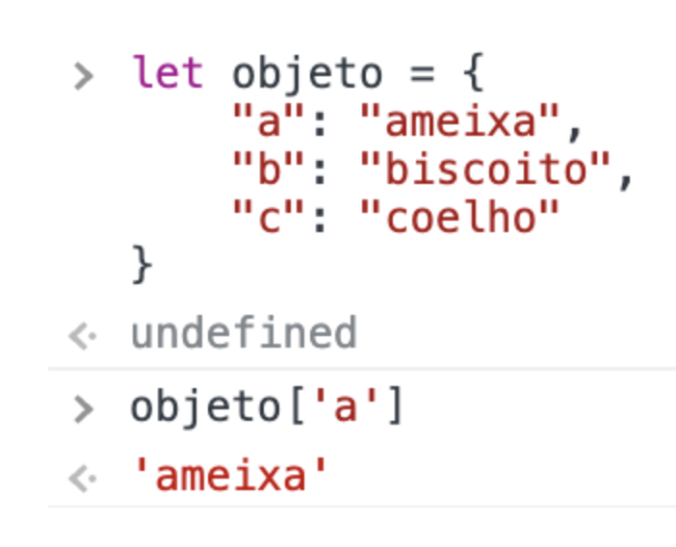
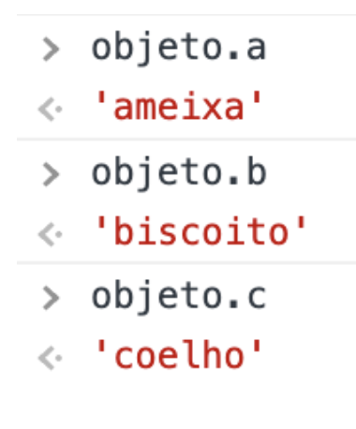

Slide 7
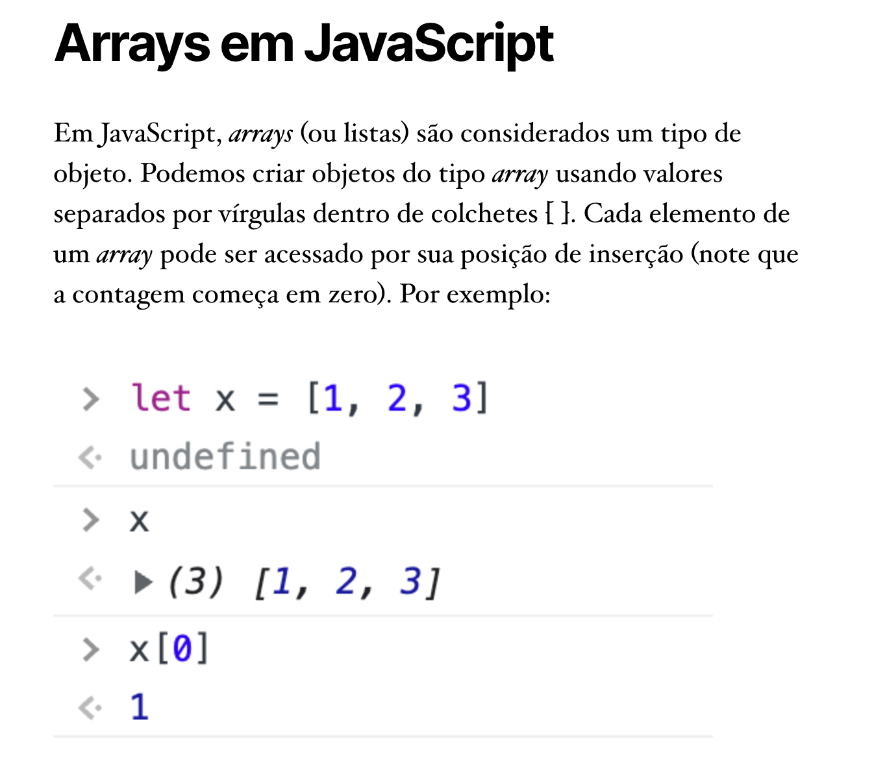

Slide 8
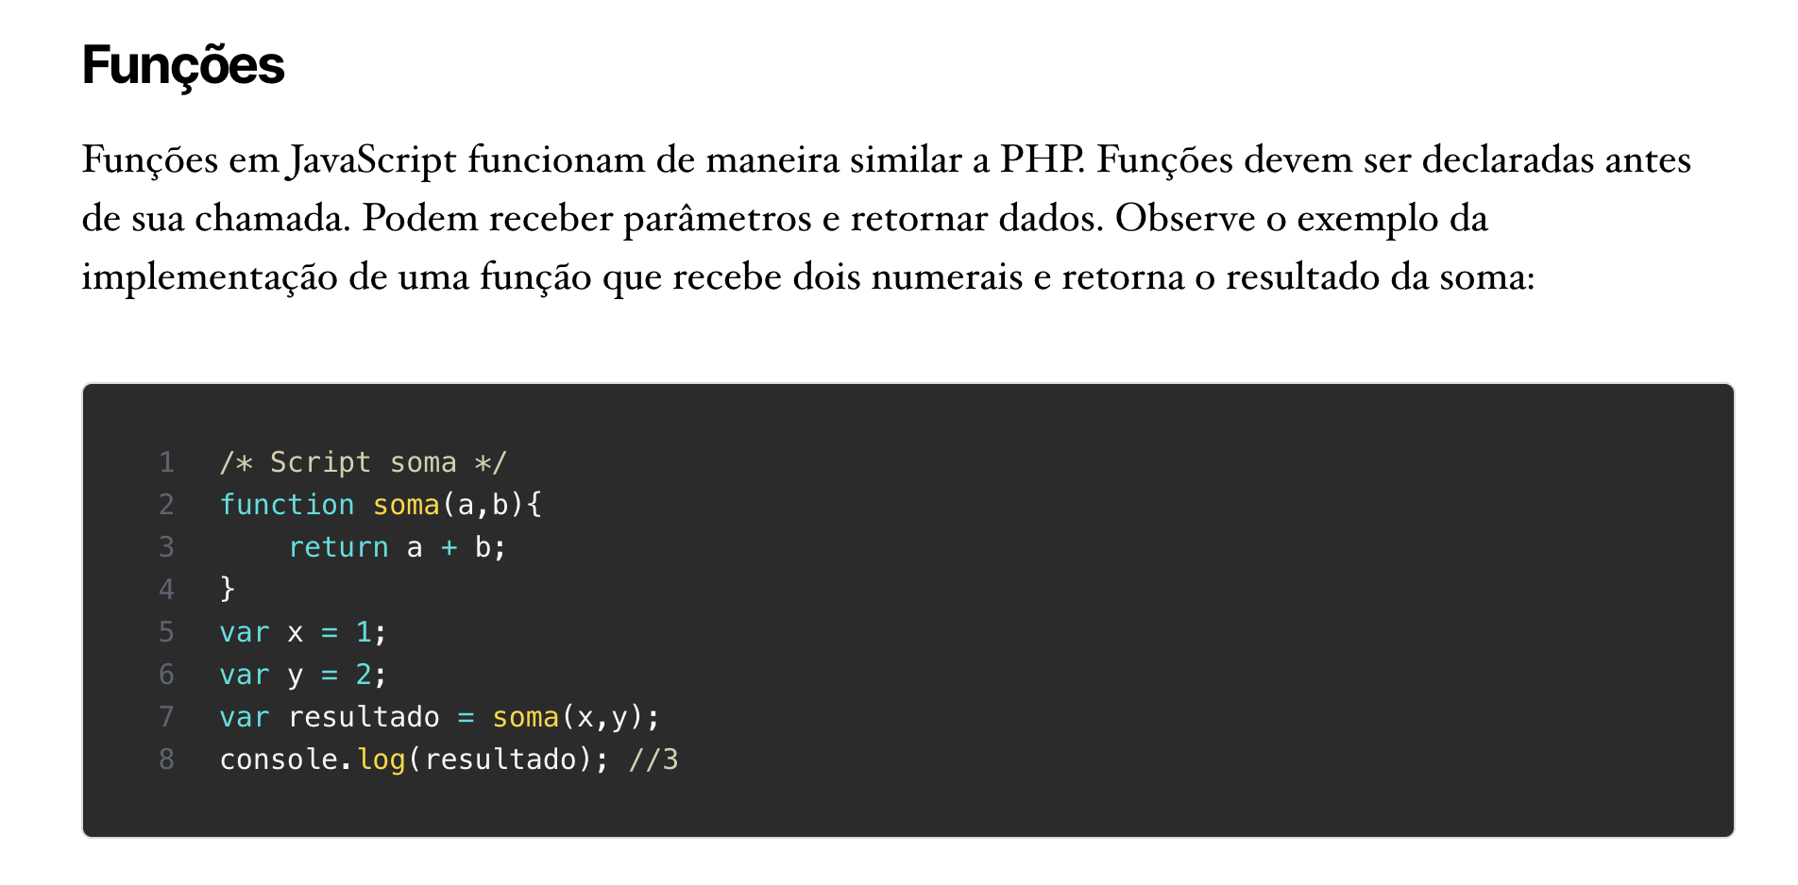

Slide 9
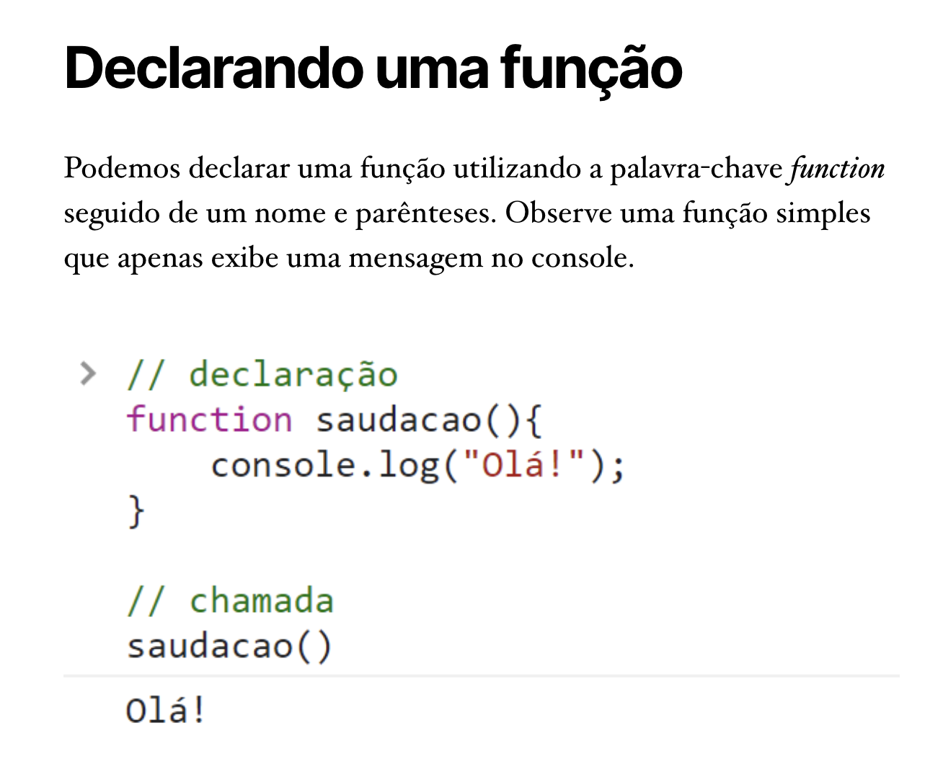

Slide 10
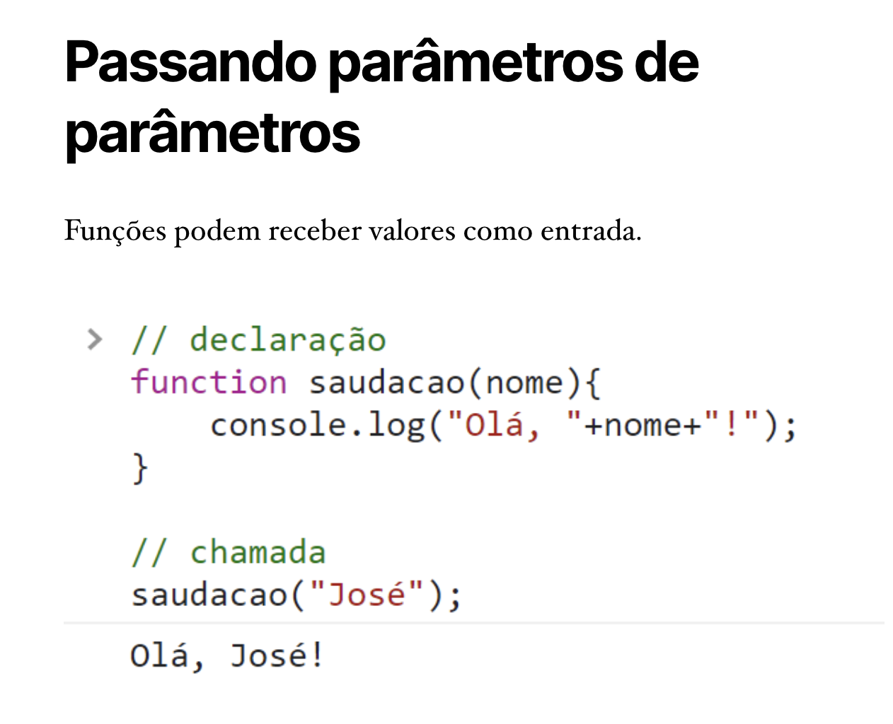
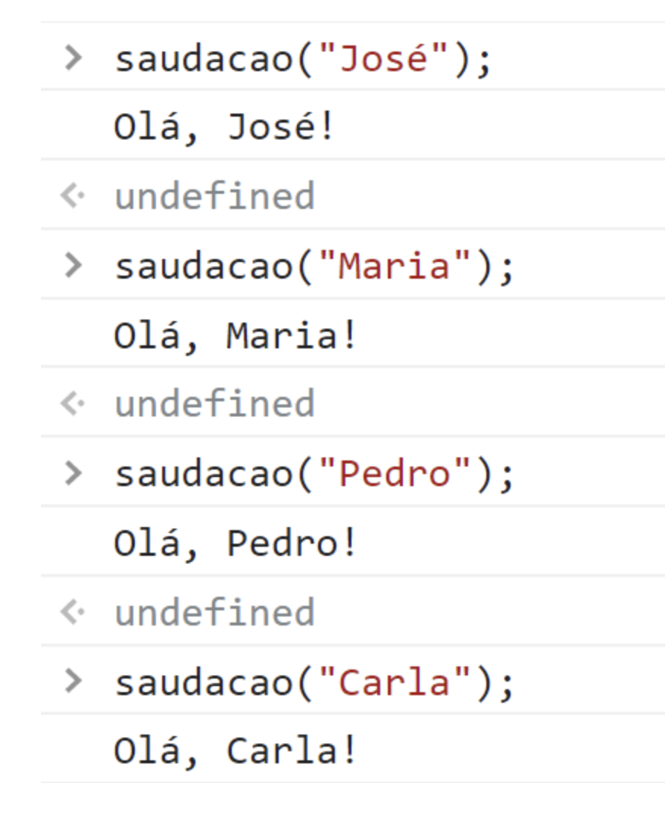

Slide 11
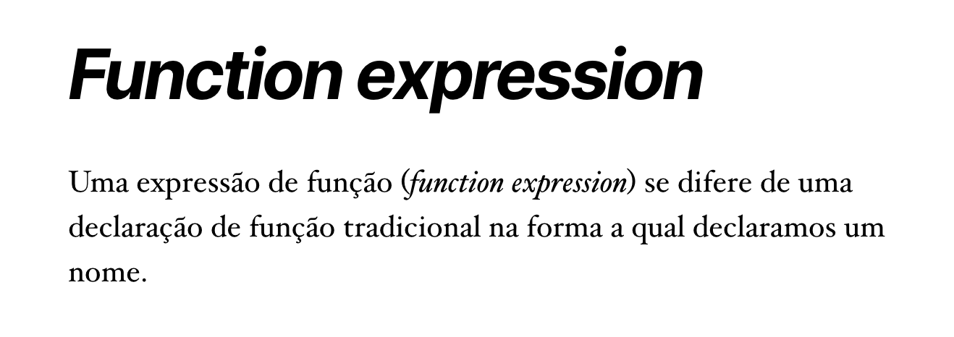
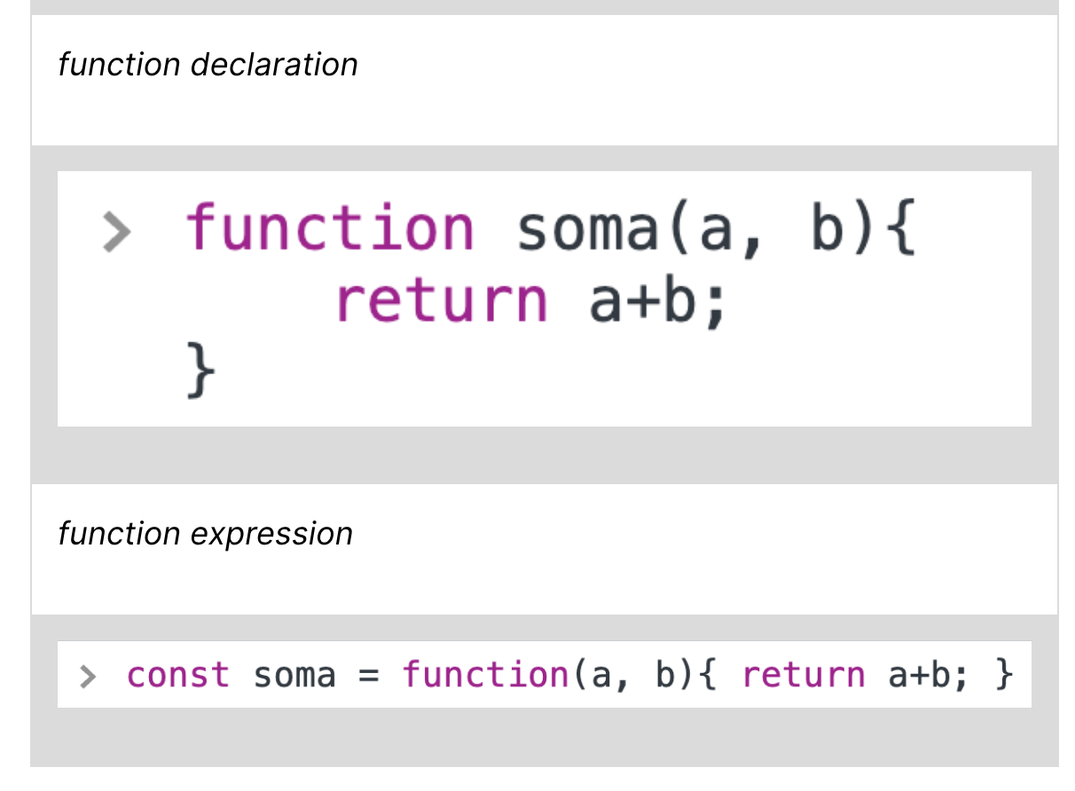

Slide 12
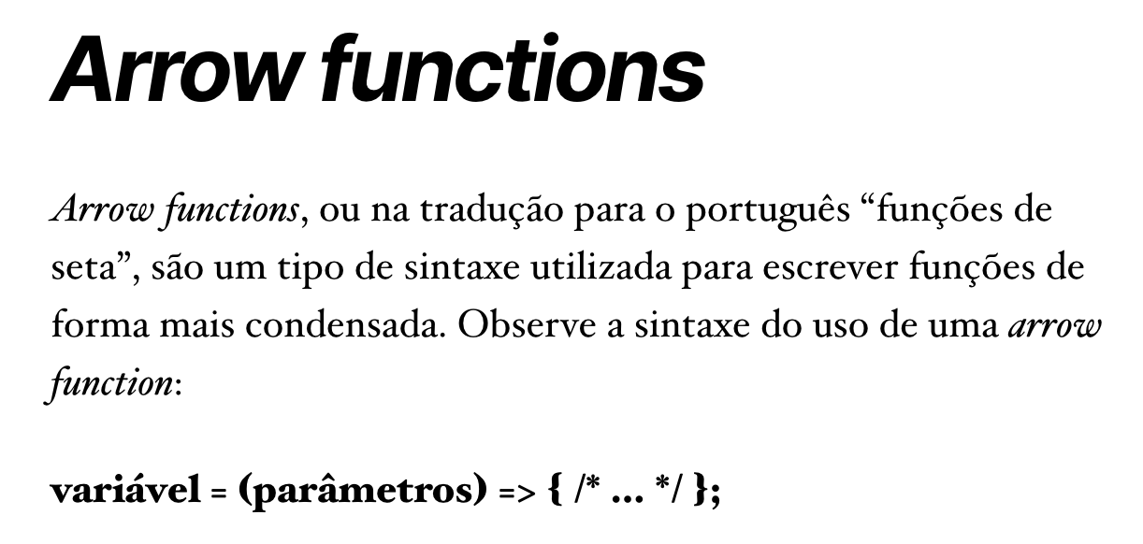
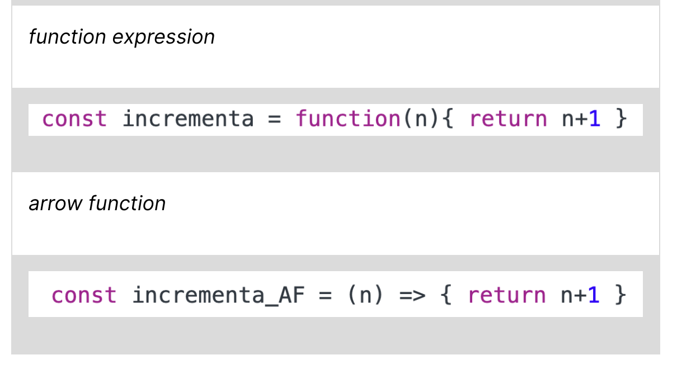

Slide 13
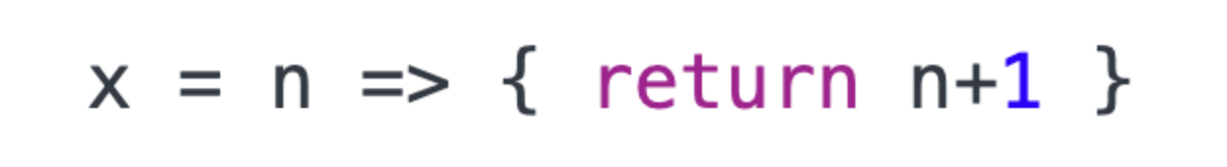
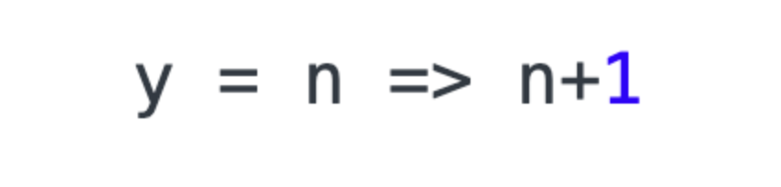
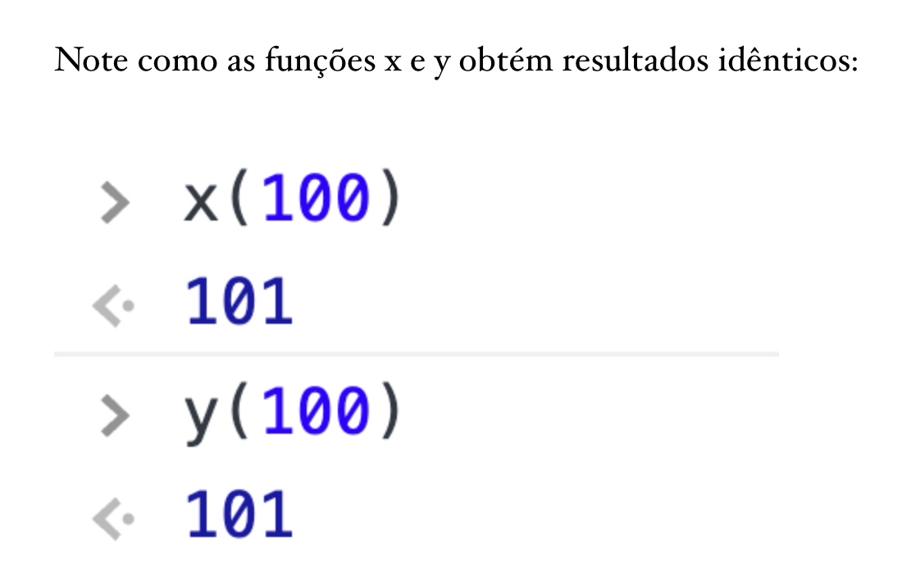
Simplificando

Slide 14
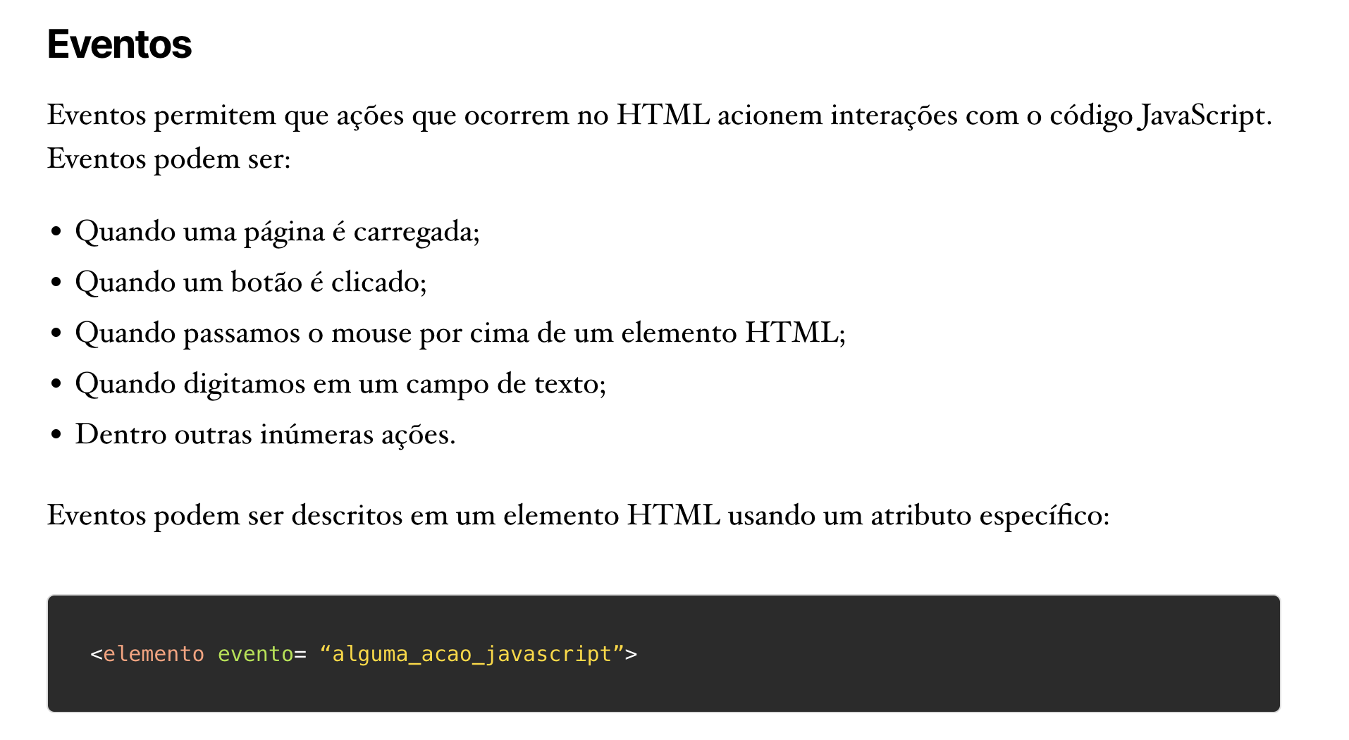

Slide 15
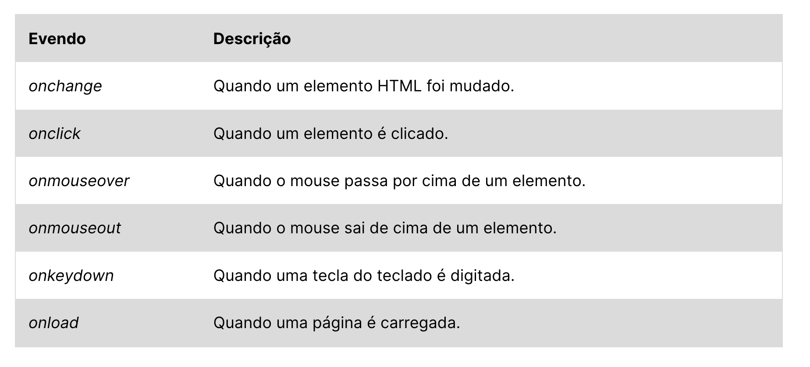

Slide 16
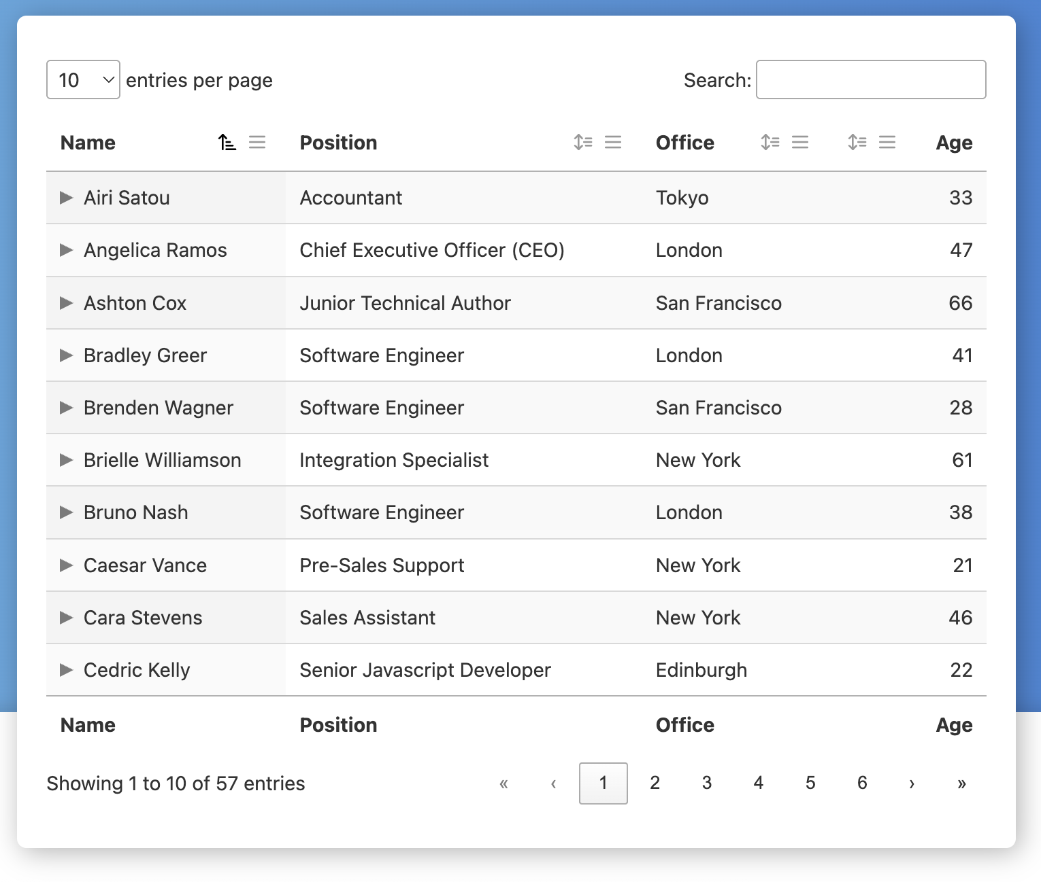
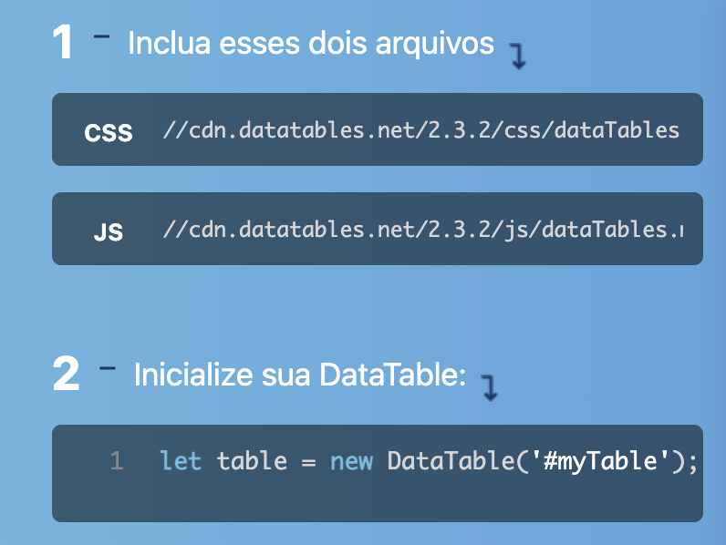
DataTables
https://datatables.net/

Slide 17
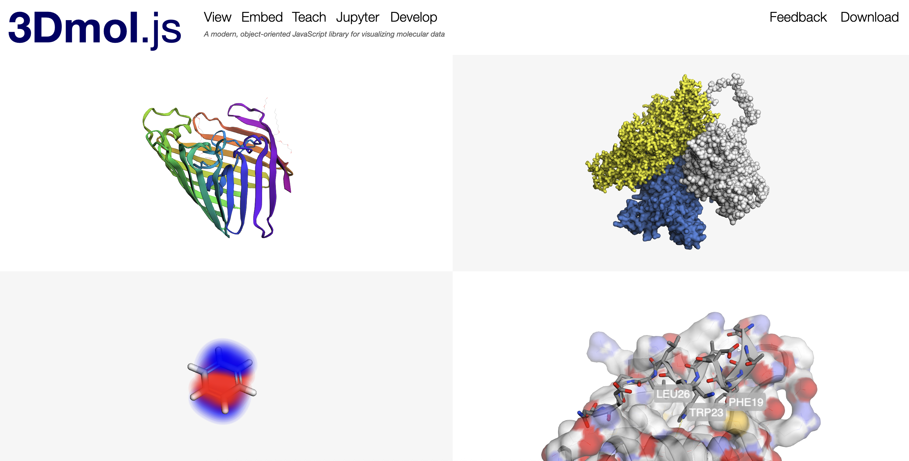
3Dmol.js
https://3dmol.csb.pitt.edu/

Slide 18
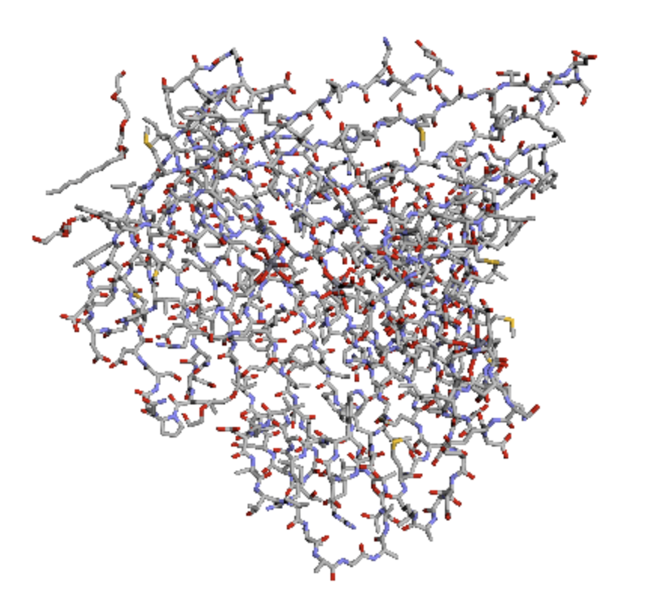
Exemplo (carregamento via HTML)
<script src="http://3Dmol.csb.pitt.edu/build/3Dmol-min.js"></script>
<div
style="height: 400px; width: 400px; position: relative;"
class='viewer_3Dmoljs’
data-pdb='2POR’
data-backgroundcolor='0xffffff’
data-style='stick’
></div>

Slide 19
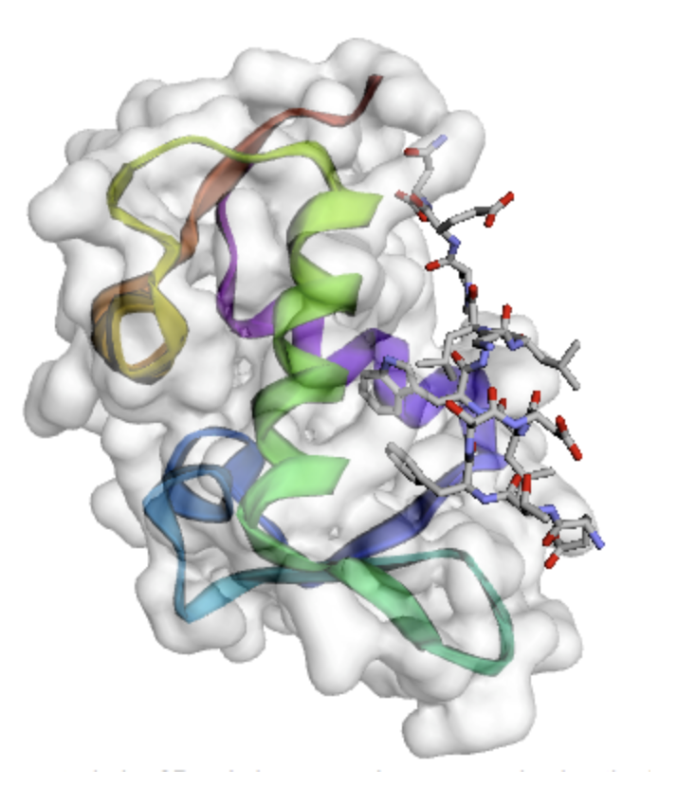
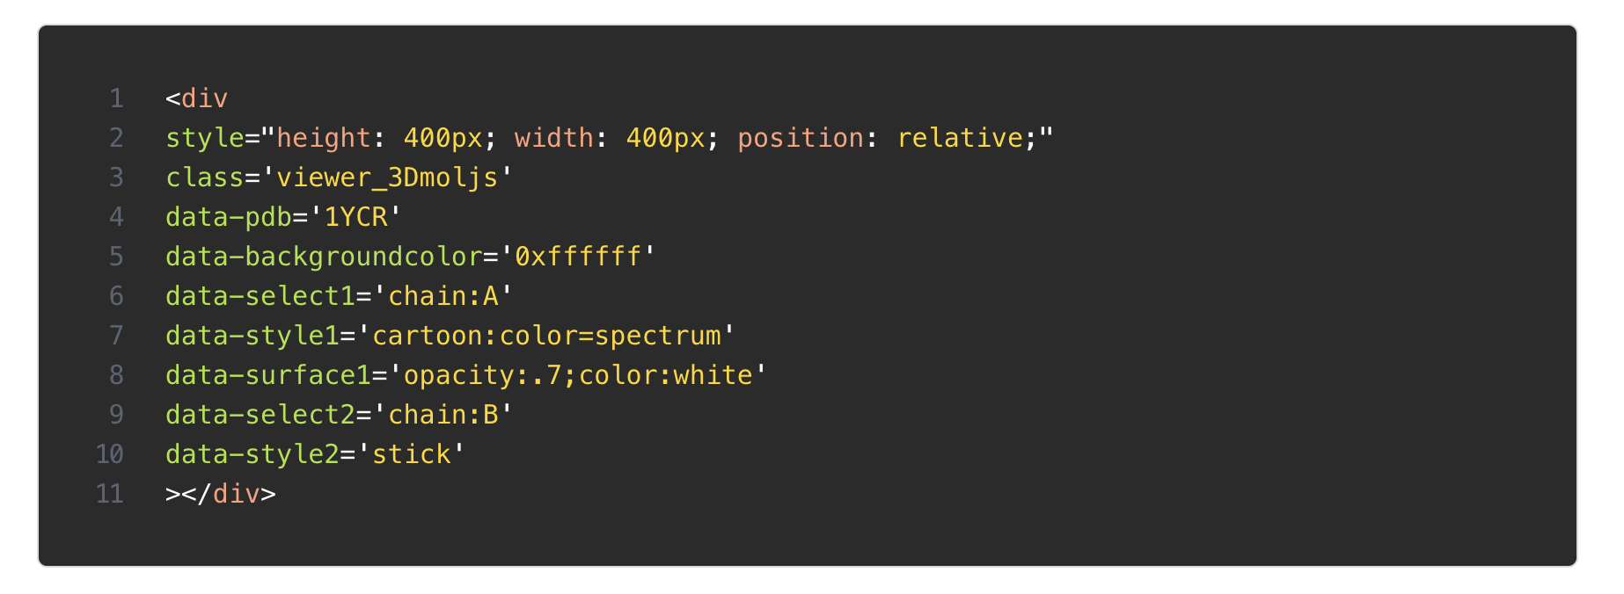
Múltiplas cadeias

Slide 20
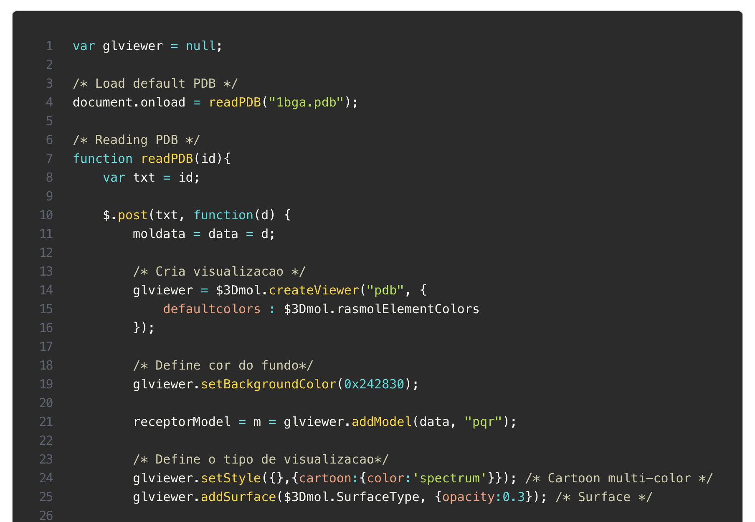
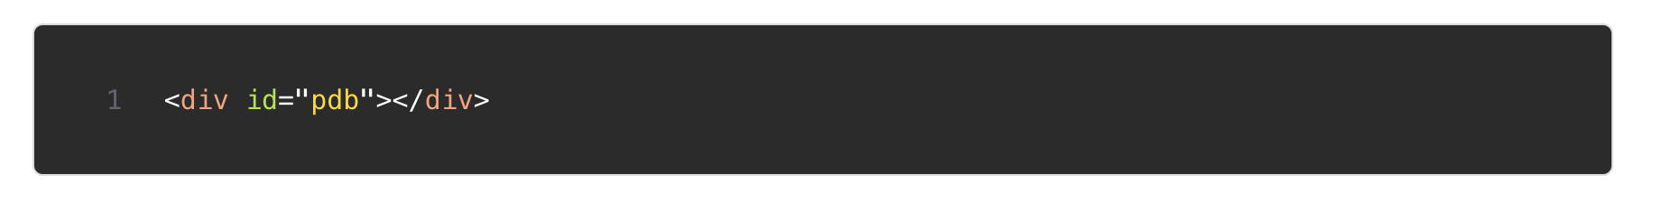
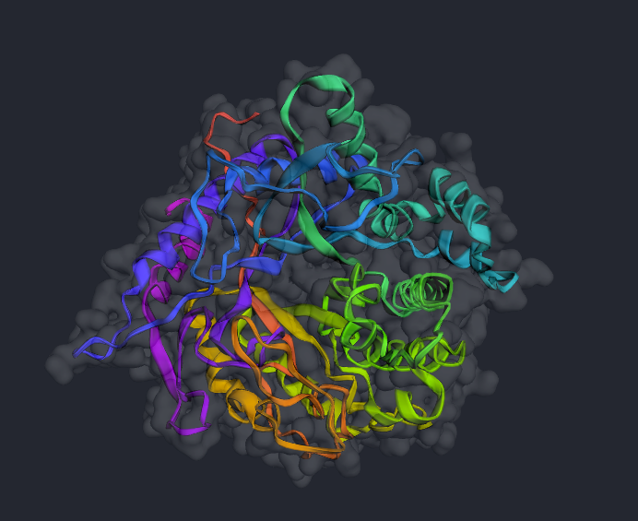
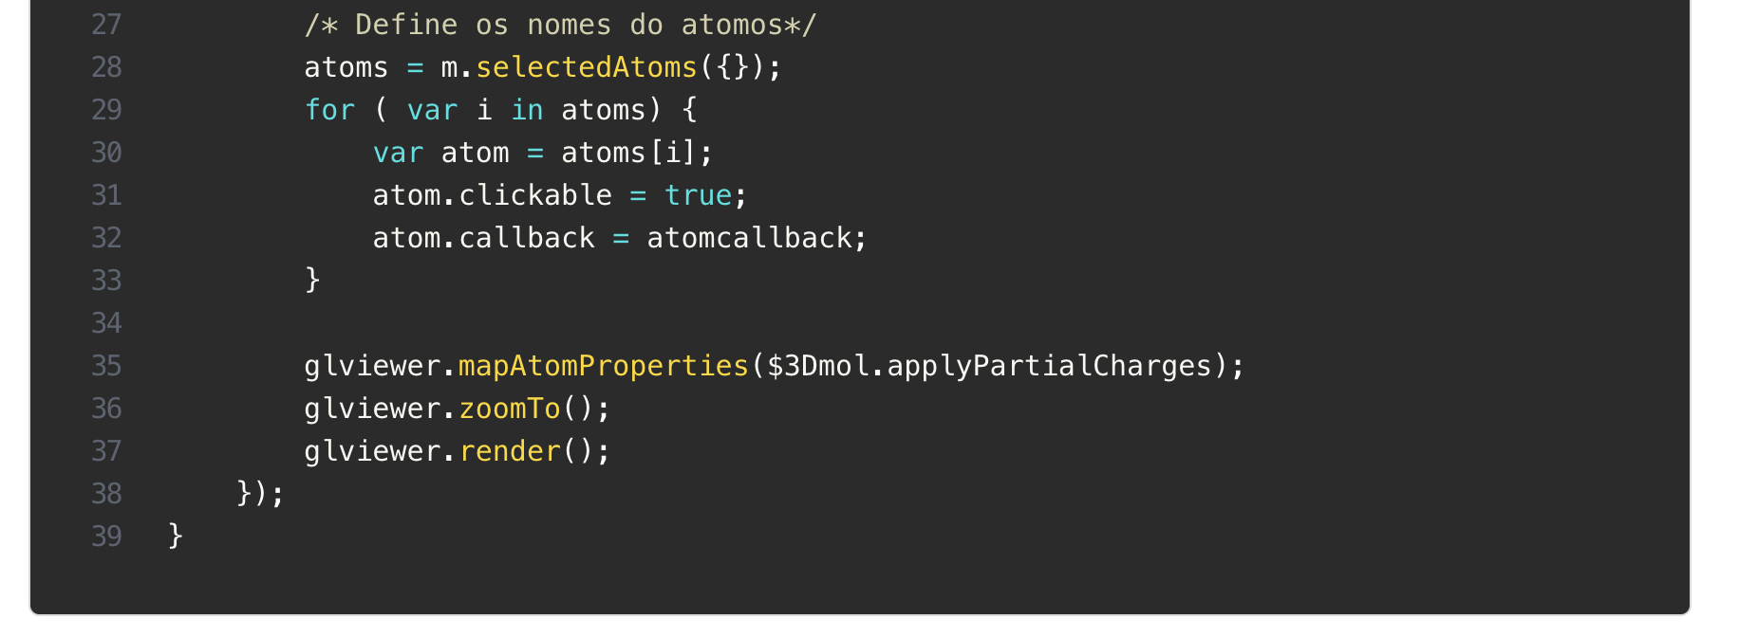
Exemplo (JavaScript)
No HTML
Notes:
var glviewer = null; /* Load default PDB */ document.onload = readPDB("1bga.pdb"); /* Reading PDB */ function readPDB(id){ var txt = id; $.post(txt, function(d) { moldata = data = d; /* Cria visualizacao */ glviewer = $3Dmol.createViewer("pdb", { defaultcolors : $3Dmol.rasmolElementColors }); /* Define cor do fundo*/ glviewer.setBackgroundColor(0x242830); receptorModel = m = glviewer.addModel(data, "pqr"); /* Define o tipo de visualizacao*/ glviewer.setStyle({},{cartoon:{color:'spectrum'}}); /* Cartoon multi-color */ glviewer.addSurface($3Dmol.SurfaceType, {opacity:0.3}); /* Surface */ /* Define os nomes do atomos*/ atoms = m.selectedAtoms({}); for ( var i in atoms) { var atom = atoms[i]; atom.clickable = true; atom.callback = atomcallback; } glviewer.mapAtomProperties($3Dmol.applyPartialCharges); glviewer.zoomTo(); glviewer.render(); }); }

